Slide 1

Lending Club Case Study
Sheetal G., Vandana.

Slide 2

PROBLEM
Problem
RISK ANALYSIS
Consumer finance company when receives a loan application, the company has to make a decision for loan approval based on the applicant’s profile.
1.BUSINESS LOSS
2.Financial LOSS
If applicant is likely to repay load then not approving the loan results in a loss of business to the company.
If applicant is not likely to repay the loan, i.e. he/she is likely to default , then approving the loan may lead to financial loss for the company.

Slide 3

SOLUTION APPROACH
1.Data understanding
We have approx. 40,000 data of historical applications, which we will use to understand data, analyze trends in data.
2.Data analysis
With the help of python – pandas, numpy libraries
3.Data visualization
With the help of python - seaborn, matplotlib libraries.
4.suggestions to consumer company
Provide points to company based on which company can make decision whether loan should be approved or denied.

Slide 4

DATA UNDERSTANDING
TOTAL DATA
FULLY PAID APPLICANTS DATA
DATASET size
39717 rows &
111 columns
32950 Rows
CURRENT APPLICANTS DATA
DEFAULTERS DATA
5627 Rows
1140 Rows

Slide 5

DATA CLEANING & IMPUTATION
Remove null columns
Segmentation – categorical data & numerical data
Remove unnecessary columns/rows
There are some columns in dataset which have absolutely null values so will removed those. Out of 111 -> 57 columns now available for analysis. Where nan present, replaced with 0.
In dataset there are columns such as id,member id which wont be useful for analysis so dropped those columns from data.
Based on number of unique values present in each column , segmentation is performed which will be useful for univariate analysis.

Slide 6

DATA VISUALIZATION

Slide 7
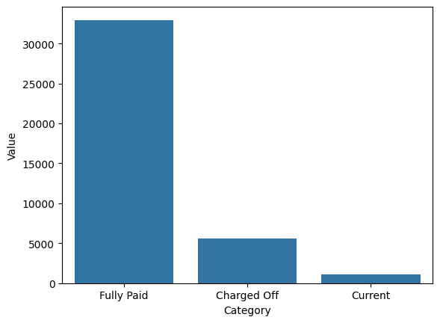
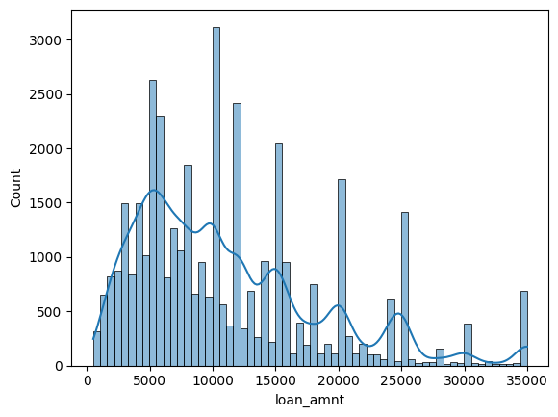
Loan status count
Loan amount varies from 5k to 35k

Slide 8
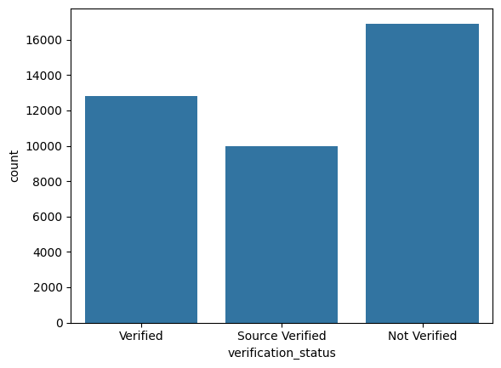
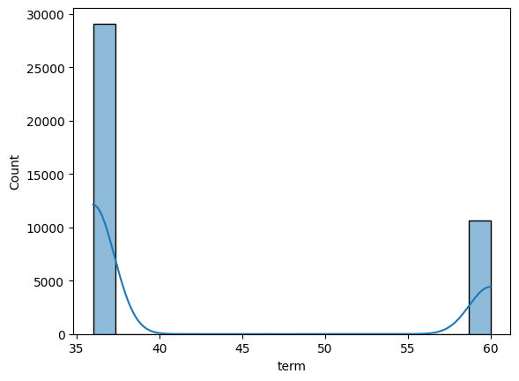
Verification status of applicants
Loan term falls in 2 categories – 36 months & 60 months

Slide 9
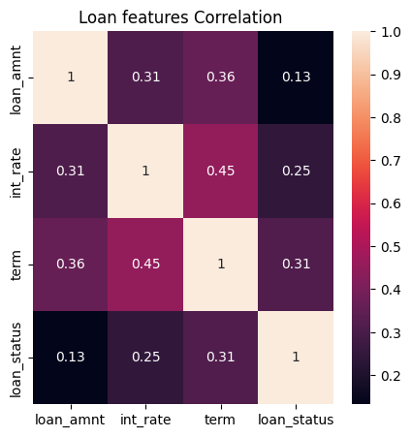
CORRELATION BETWEEN LOAN DATA

Slide 10
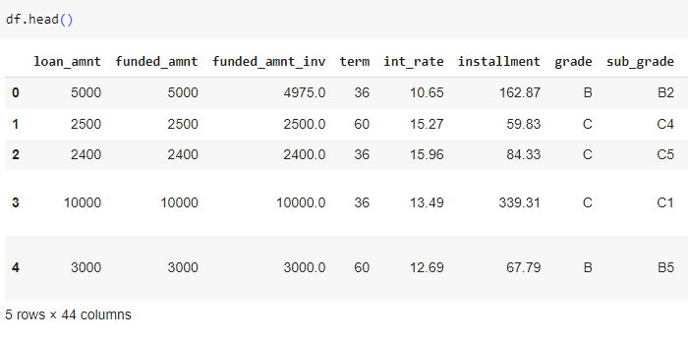
DATASET AFTER EDA

Slide 11

Summary
Factors need to consider before loan approval
Loan purpose should be checked.
Check loan term of applicant. Long term loan are not suggested.
Verification should be done time to time.
4. Applicant’s employment length should be checked. Employment length between 3 to 9 yrs is suggested.
NOTE :
After analysing data, these points have came in picture. Apart from this, applicants proper background verification and time to time inquiry is suggested.
summary

Slide 12

THANK YOU
About

